Slide 1
Supervised
Machine Learning
Eng- Mohamed Khaled Idris
Eng- Mayar Swilam

Slide 2
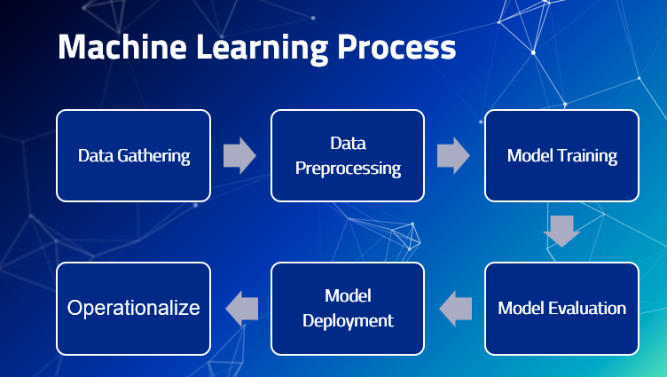

Slide 3
What is Machine Learning ?
Machine Learning is a branch of artificial intelligence that is concerned with the development of algorithms which allow a computer to learn automatically from the past data and past experiences.
Machine learning builds mathematical or statistical models to make predictions using historical data or information.
Historical data: Known as Training data

Slide 4
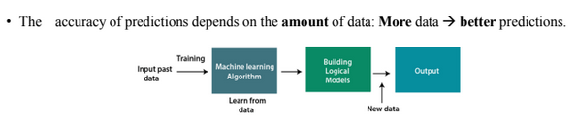
Always in Machine Learning

Slide 5
How Machine Learns ?
Data storage utilizes observation, memory, and recall to provide a factual basis for further reasoning.
Abstraction involves transforming raw data into higher-level representations or features that capture essential information. This process often includes data preprocessing, feature engineering, and data transformation to make it suitable for modeling. Abstraction is essential for reducing noise and highlighting relevant patterns.
Generalization uses abstracted data to create knowledge and inferences that drive action in new contexts.
Evaluation provides a feedback mechanism to measure the utility of learned knowledge and inform potential improvements.

Slide 6
Different types of models
Mathematical equations
Statistical Models
Relational diagrams such as trees and graphs
Logical if/else rules
Groupings of data known as clusters

Slide 7
Abstraction
The process of fitting a model to a dataset is known as training. When the model has been trained, the data is transformed into an abstract form that summarizes the original information.
Note ! You might wonder why this step is called training rather than learning.
First, note that the process of learning does not end with data abstraction; the learner must still generalize and evaluate its training.
Second, the word training better connotes the fact that the human teacher trains the machine student to understand the data in a specific way.

Slide 8
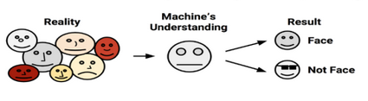
Generalization
The term generalization describes the process of turning abstracted knowledge into a form that can be utilized for future action, on tasks that are similar, but not identical, to those it has seen before.
In generalization, the learner is tasked with limiting the patterns it discovers to only those that will be most relevant to its future tasks.
The algorithm is said to have a bias if the conclusions are systematically erroneous, or wrong in a predictable manner.

Slide 9
Evaluation
Therefore, the final step in the generalization process is to evaluate or measure the learner’s success in spite of its biases and use this information to inform additional training if needed.
Generally, evaluation occurs after a model has been trained on an initial training dataset. Then, the model is evaluated on a new test dataset in order to judge how well its characterization of the training data generalizes to new, unseen data.

Slide 10
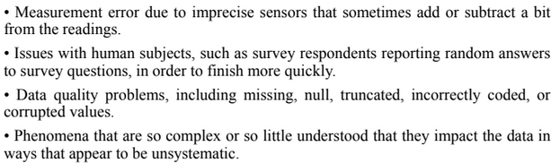
Evaluation (Cont.)
In parts, models fail to perfectly generalize due to the problem of noise, Noisy data is caused by seemingly random events, such as:
Trying to model noise is the basis of a problem called OVERFITTING !

Slide 11
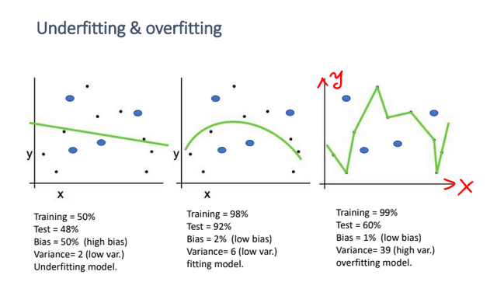
Underfitting
VS.
Overfitting
VS.
Good Fitting

Slide 12
Training Dataset
The training set is the portion of the dataset that is used to train the machine learning model. It contains labeled examples (input data and corresponding target labels) that the model uses to learn the patterns and relationships in the data.
The goal is for the model to generalize from the training data and capture the underlying patterns so that it can make accurate predictions on new, unseen data.

Slide 13
Validation Dataset
The validation set is used during the training process to fine-tune the model's hyperparameters and monitor its performance. It is separate from the training set and contains examples that the model has not seen during training.
The validation set allows you to assess the model's performance on unseen data and make decisions about parameter adjustments, such as adjusting the learning rate or choosing the number of hidden units in a neural network
By evaluating the model's performance on the validation set, you can make informed decisions to improve the model's generalization capabilities.

Slide 14
Test Dataset
The test set is used to evaluate the final performance of the trained machine learning model. It is a separate, independent dataset that the model has never seen before during training or validation.
The purpose of the test set is to provide an unbiased assessment of the model's performance on completely new data.
By evaluating the model on a test set, you can estimate how well the model is likely to perform in real-world scenarios.

Slide 15
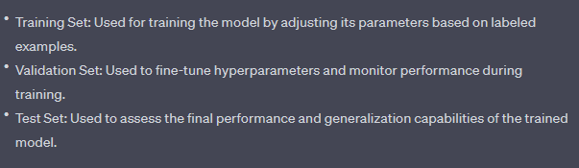
Training VS. Validation VS. Test

Slide 16
Additional Machine Learning Methods
Methods based on the ability to learn from incremental data samples:
Batch Learning
Online Learning
Methods based on their approach to generalization from data samples:
Instance based learning
Model based learning

Slide 17
Supervised Learning (Classification)

Slide 18
What is Classification ?
Classification is a fundamental task in machine learning and data analysis. It involves categorizing data instances into predefined classes or categories based on their features or attributes.
The goal of classification is to build a predictive model that can assign the correct class label to new, unseen data based on patterns and relationships learned from a labeled dataset.
In a classification problem, you have a dataset containing examples with their corresponding class labels.

Slide 19
Types of Classification
Binary Classification
Multi Classification

Slide 20
Nearest Neighbor

Slide 21
Nearest Neighbor
Neighbors-based classification is a type of instance-based learning or non-generalizing learning: it does not attempt to construct a general internal model, but simply stores instances of the training data.
Classification is computed from a simple majority vote of the nearest neighbors of each point: a query point is assigned the data class which has the most representatives within the nearest neighbors of the point.neighbours

Slide 22
What is K-Nearest Neighbors (KNN) ?
K-Nearest Neighbors (KNN) is a simple yet powerful machine learning algorithm used for both classification and regression tasks.
It is a non-parametric and instance-based learning algorithm, meaning it makes predictions based on the similarity between input data points and the data points in its training set.

Slide 23
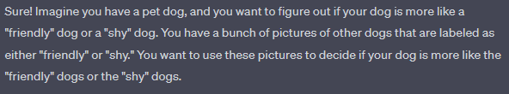
Storytelling of GPT

Slide 24
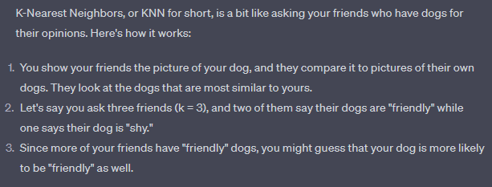
Storytelling of GPT (Cont.)

Slide 25
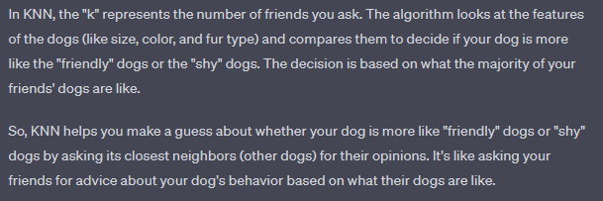
Storytelling of GPT (CONT.)

Slide 26
How it works ?
Training Phase:
The algorithm is provided with a labeled training dataset, where each data point consists of features (attributes) and a corresponding class label (for classification) or a target value (for regression).
KNN does not explicitly "train" a model like many other algorithms. Instead, it memorizes the entire training dataset.

Slide 27
How it works ? (Cont.)
Prediction Phase:
When a new, unlabeled data point needs to be classified or predicted, KNN identifies the "k" closest data points (neighbors) from the training dataset based on a distance metric, often using Euclidean distance.
The value of "k" is a user-defined parameter that determines how many neighbors influence the prediction. For example, if k = 3, the algorithm considers the labels or values of the three closest neighbors.
It has no loss function !

Slide 28
How it works ? (Cont.)
Classification:
For classification tasks, the algorithm assigns the class label that is most common among the k nearest neighbors. This is often done using majority voting. For instance, if out of the k neighbors, 2 belong to class A and 1 belongs to class B, the algorithm would predict class A for the new data point.
In other words, it is the using of MODE

Slide 29
Similarity Metrics for KNN
Euclidean Distance
Manhattan Distance
Chebyshev Distance
Minkowski Distance
Hamming Distance
L1 Norm
L2 Norm
Jaccard Similarity

Slide 30
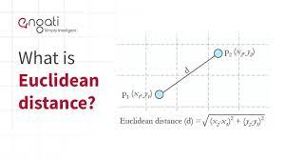
Euclidean Distance (L2 Norm)
This is the most common distance metric and is used for continuous numerical data.
It calculates the straight-line distance between two points in the feature space. If you have two points with coordinates (x1, y1) and (x2, y2), the Euclidean distance is:

Slide 31
Manhattan Distance (L1 Norm)
Also known as the "city block" or "taxicab" distance, this metric calculates the distance by summing the absolute differences between corresponding coordinates.
It's often used when movement can only occur along grid lines (like streets in a city).

Slide 32
Chebyshev Distance
This metric calculates the maximum absolute difference between coordinates.
It's useful when you want to emphasize the largest difference between dimensions.

Slide 33
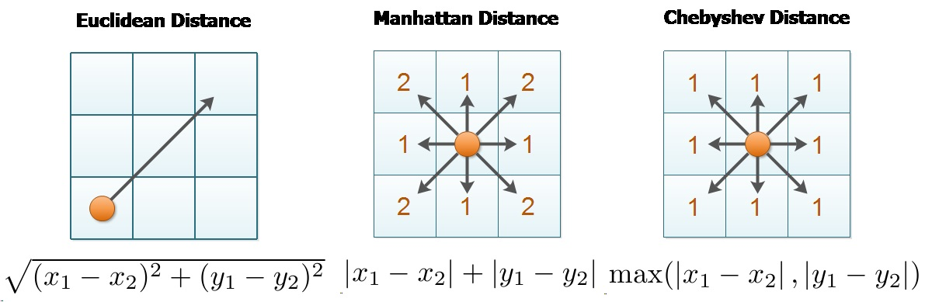

Slide 34
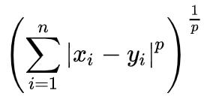
Minkowsky Distance
This is a generalization of both Euclidean and Manhattan distances. It includes a parameter "p" that allows you to control the distance calculation.
When p = 1, it's equivalent to the Manhattan distance, and when p = 2, it's the Euclidean distance.

Slide 35
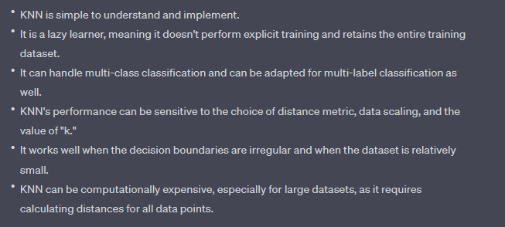
Pros & Cons.

Slide 36
Decision Tree

Slide 37
A SEQUENCE OF DECISIONS
In the summer days, do you have any criteria to get up from your bed and get out into the hot weather for important mission ?
Is there a truly something important to make you go out in that hot weather ?
You should re-consider you Decisions based on your priorities. You can use such a thing that makes logic rules that help you make a decision such as:
Decision Tree

Slide 38
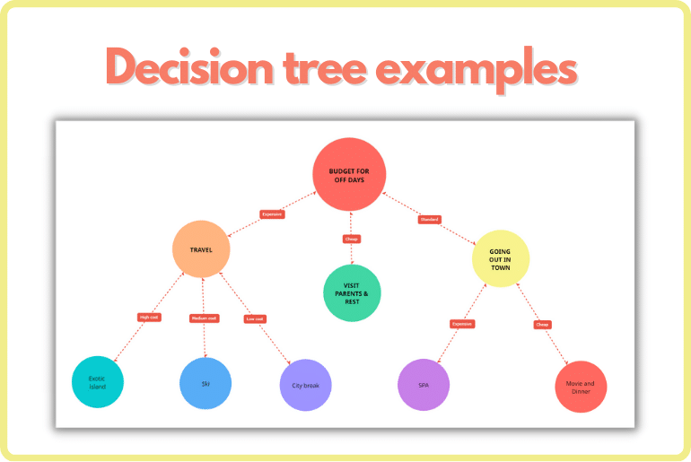

Slide 39
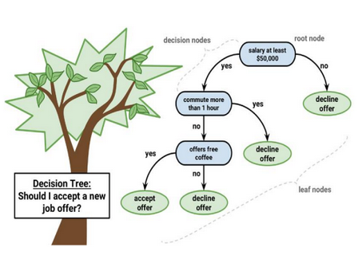

Slide 40
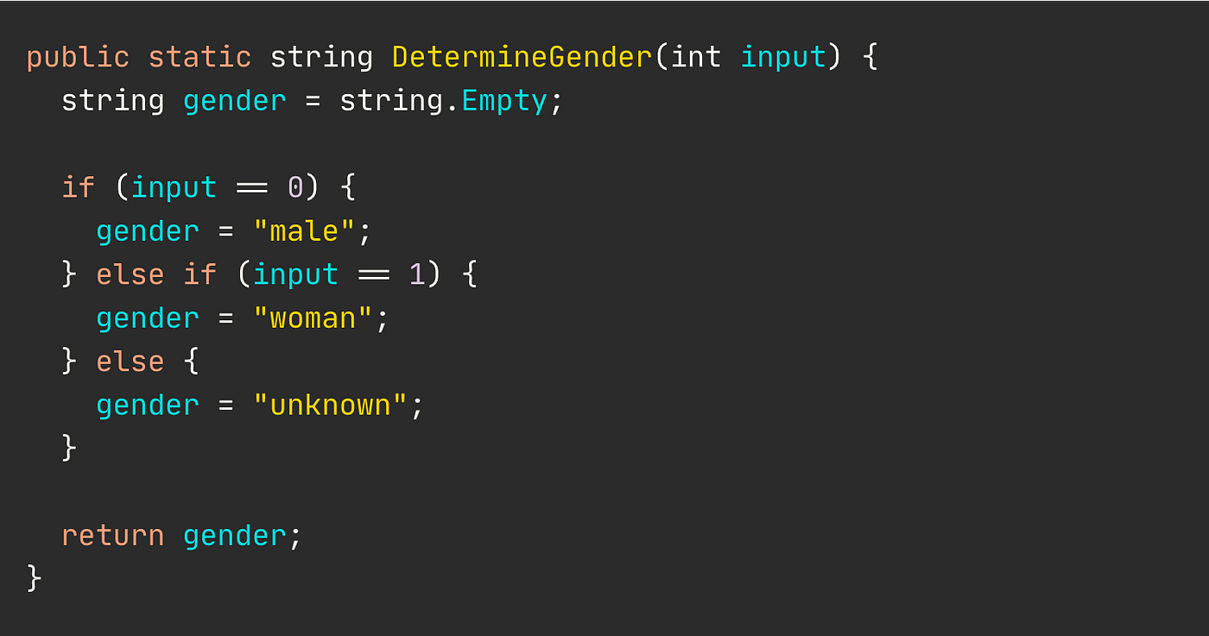
Something you may be familiar with
(Group of if-elseif statements)

Slide 41
What is “Decision Tree” ?
Decision tree is one of the most powerful tools of supervised learning algorithms used for both classification and regression tasks in machine learning.
It builds a flowchart-like tree structure where each internal node denotes a test on an attribute, each branch represents an outcome of the test, and each leaf node (terminal node) holds a class label.
It is constructed by recursively splitting the training data into subsets based on the values of the attributes until a stopping criterion is met, such as the maximum depth of the tree or the minimum number of samples required to split a node.

Slide 42
Why Decision Tree ?
A decision tree simply asks a question and based on the answer (Yes/No), it further split the tree into sub-trees.

Slide 43
Before going to Decision Tree
You should know some
TERMINOLOGIES

Slide 44
Decision Tree Terminologies
Terminology | Description
Root Node | Root node is from where the decision tree starts. It represents the entire dataset, which further gets divided into two or more homogeneous sets.
Decision/Internal Node | A node that symbolizes a choice regarding an input feature. Branching off of internal nodes connects them to leaf nodes or other internal nodes.
Leaf/Terminal Node | A node without any child nodes that indicates a class label or a numerical value.
Splitting | The process of splitting a node into two or more sub-nodes using a split criterion and a selected feature.
Branch/Sub-Tree | A subsection of the decision tree starts at an internal node and ends at the leaf nodes
Pruning | The process of removing branches from the tree that do not provide any additional information or lead to overfitting (Optimization)

Slide 45
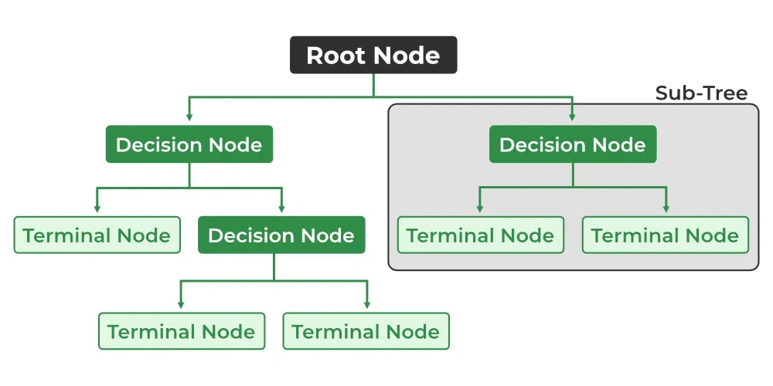
Selected Feature Decisions
(Condition)
Entire Dataset

Slide 46
Some Notes you should Remember !
Decision tree is not unique, as different ordering of internal nodes can give different decision tree.
Decision tree may be n-ary, n ≥ 2.
All nodes drawn with circle (ellipse) are called internal nodes.
All nodes drawn with square boxes are called terminal nodes or leaf nodes.
Edges of a node represent the outcome for a value of the node.
In a path, a node with same label is never repeated.

Slide 47
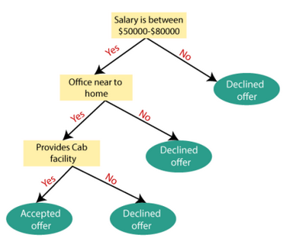
Example
Suppose there is a candidate who has a job offer and wants to decide whether he should accept the offer or Not. So, to solve this problem, the decision tree starts with the root node (Salary attribute by Attribute Selection Measure –ASM- ).

Slide 48
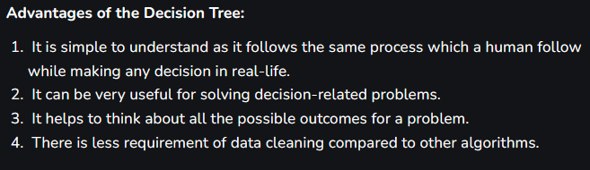
Decision Tree Advantages

Slide 49
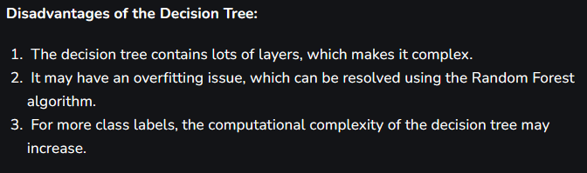
Decision Tree disadvantages

Slide 50
Support-Vector Machine

Slide 51
What is Support-Vector Machine ?
A Support Vector Machine (SVM) is a powerful and versatile supervised machine learning algorithm used for both classification and regression tasks.
SVMs are particularly effective in scenarios where there is a clear separation between classes or when the data is not linearly separable.
What is the main goal ?
The main goal of an SVM is to find a hyperplane (or decision boundary) that best separates the data into different classes while maximizing the margin between the classes.

Slide 52
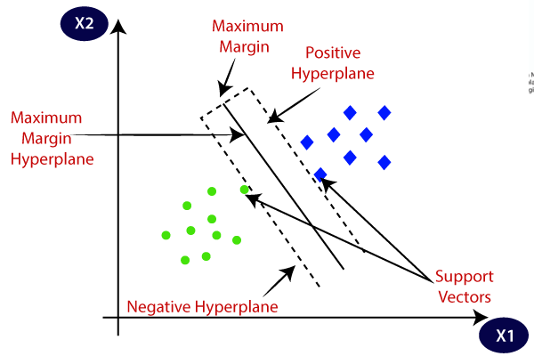

Slide 53
Important Terms
Hyperplane: A hyperplane is a decision boundary that separates data points of different classes. In a binary classification problem, it's a line in two dimensions or a hyperplane in higher dimensions.
Support Vectors: These are the data points that are closest to the hyperplane and have the most influence in determining its position. Support vectors define the margin and play a crucial role in SVM.
Margin: The margin is the distance between the hyperplane and the nearest data points (support vectors) of each class. SVM aims to maximize this margin.
Kernel: A kernel function is used to transform the data into a higher-dimensional space, allowing SVM to find a hyperplane in a transformed feature space.

Slide 54
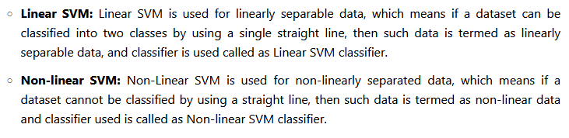
Types of SVM

Slide 55
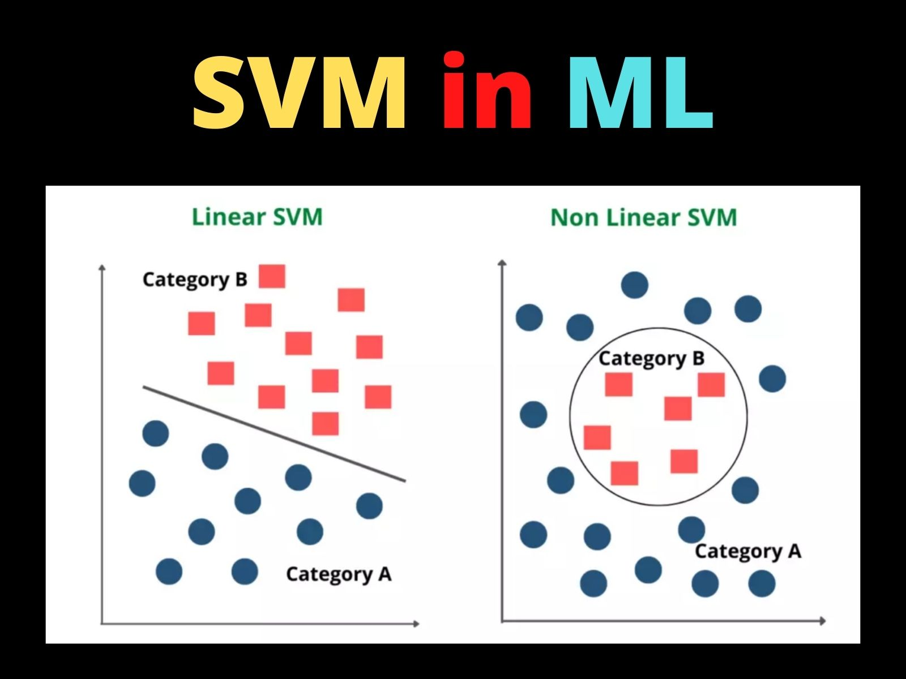

Slide 56
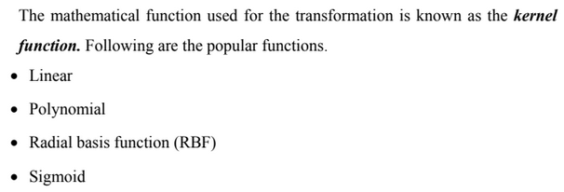
Existence of the Kernels (hyperplane)

Slide 57
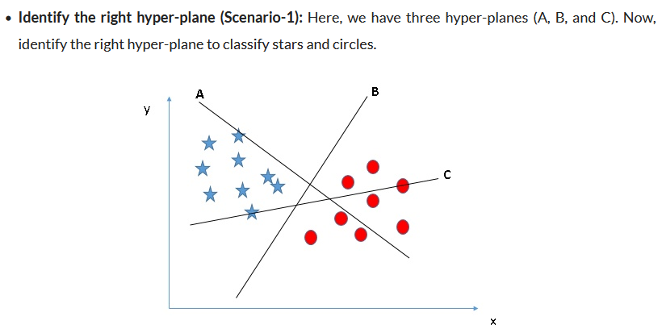
Why “Margin” ?

Slide 58
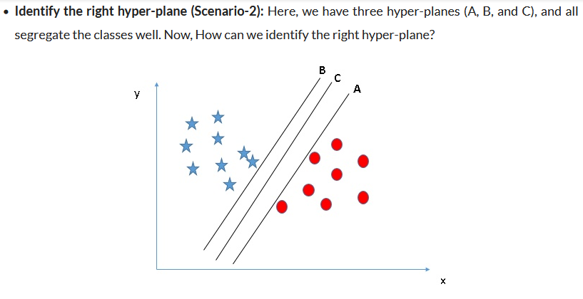
Why “Margin” ? (Cont.)

Slide 59
The learning Process
The distance of the vectors from the hyperplane is called the margin which is a separation of a line to the closest class points.
We would like to choose a hyperplane that maximizes the margin between classes.
Soft Margin
Hard Margin

Slide 60
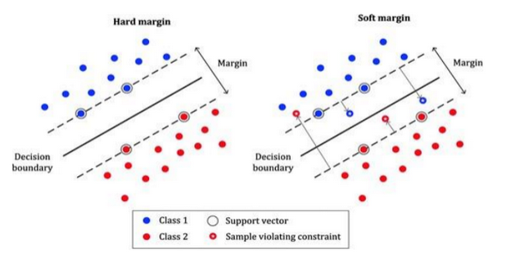
The cost function is to maximize the margin

Slide 61
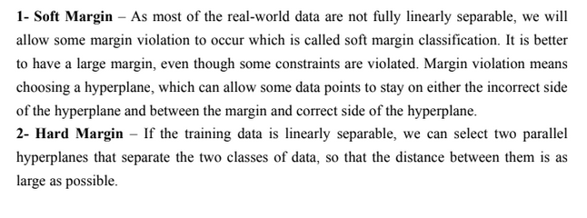
Soft VS. Hard Margin

Slide 62
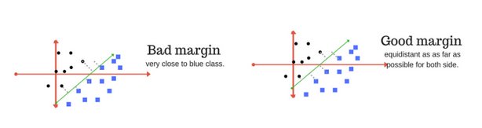
Good Fitting
A good margin is one where this separation is larger for both the classes. Images below gives to visual example of good and bad margin.

Slide 63
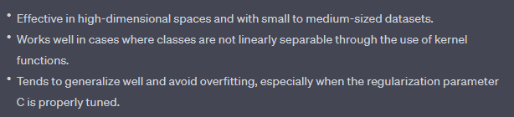
Advantages

Slide 64
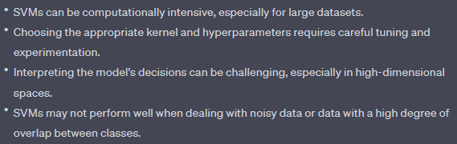
Limitations

Slide 65
Evaluation Metrics

Slide 66
Evaluation Metrics
Each Machine Learning Problem has it is own Evaluation Metrics

Slide 67
Classification Evaluation Metrics
Evaluation metrics for classification are used to assess the performance of a classification model by comparing its predictions to the actual class labels in a dataset.
These metrics help quantify how well the model is performing and provide insights into its strengths and weaknesses.
Accuracy | Precision | Recall | F1-Score | ROC | AUC

Slide 68
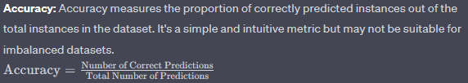
Accuracy

Slide 69

Confusion Matrix

Slide 70
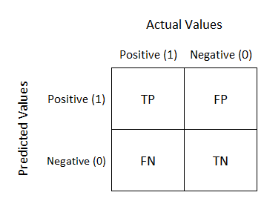

Slide 71

Precision
Used for Medical Diagnosis

Slide 72

Recall
Used for information Retreiving

Slide 73

Questions

Slide 74
Thank you

